Slide 1

Quantization Noise in Digital Imaging
Identifying its Impact and Graphical Analysis
Presented By
Jerin J
192425070

Slide 2
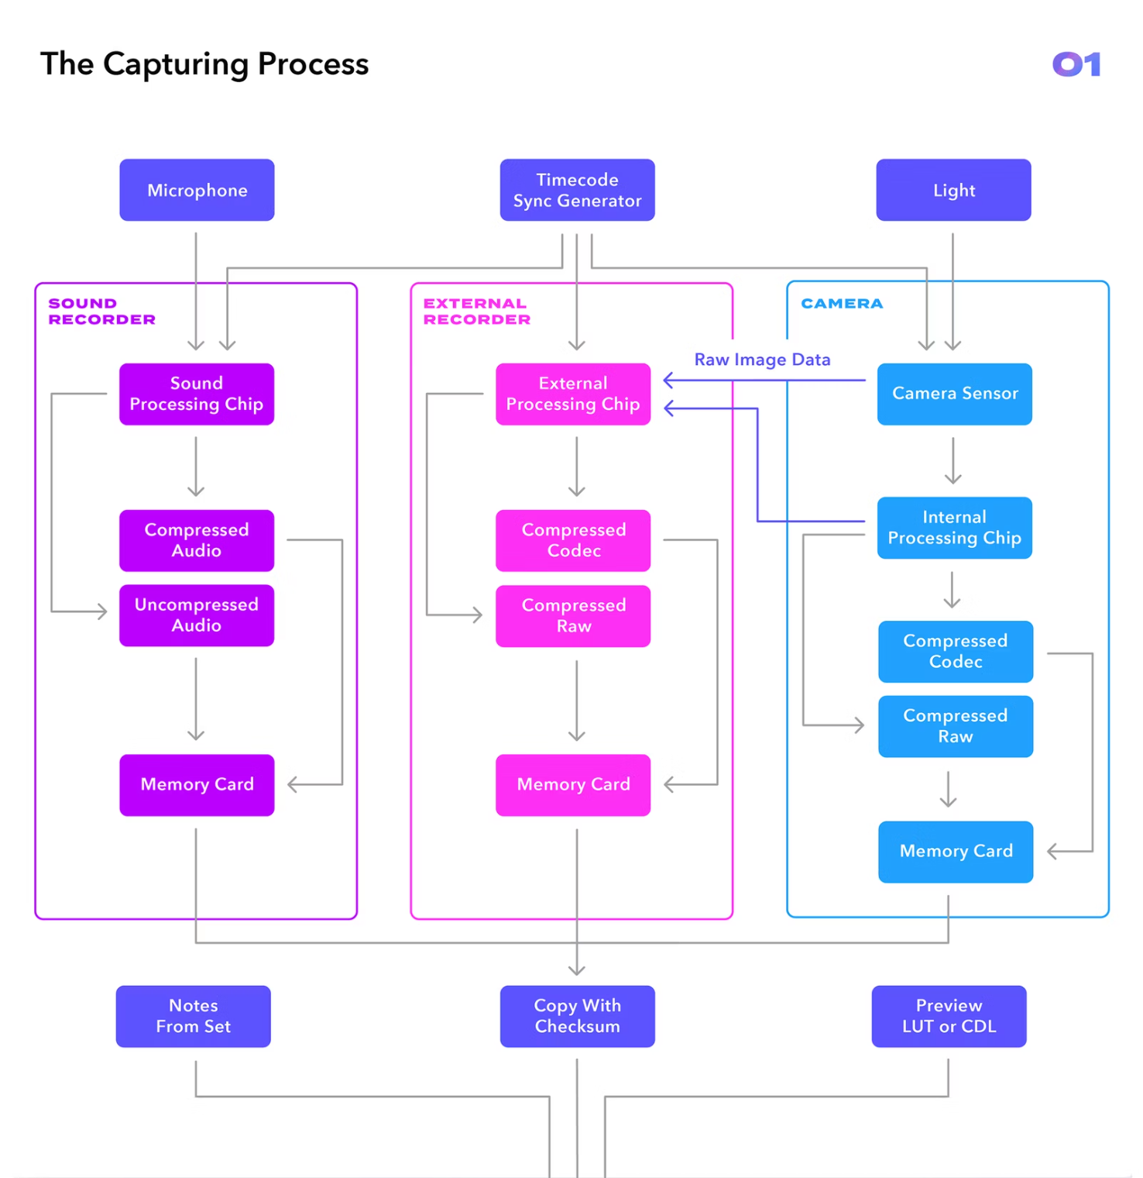
Introduction to Quantization
Definition: Quantization maps continuous intensity values to discrete digital levels.
Role: Final step after sampling to produce pixel values for storage and processing.
Sampling vs Quantization: Sampling fixes spatial coordinates; quantization discretizes amplitude (intensity).
Importance for CV: Affects feature extraction, visual fidelity, and algorithmic robustness.
Bit depth → Gray levels (examples)
Bit depth
Gray levels
2-bit
4
4-bit
16
8-bit
256
16-bit
65536

Slide 3
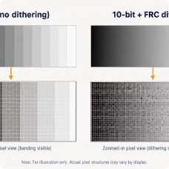


Quantization Noise — What and Why
Causes
Visual Example
Limited gray levels
Low bit depth (coarse levels)
Analog-to-digital converter resolution and linearity
Compression quantization (lossy codecs)
Limited gray-level representation
Low bit depth
4-bit shows banding and stepped intensities;
8-bit preserves smooth gradients.
Restricted tonal resolution
Coarse discrete levels
Quantization Noise
Compression artifacts
ADC limitations
Lossy codec quantization
Converter resolution and linearity
Definition (simple): Quantization Noise = Original Pixel Value − Quantized Pixel Value

Slide 4
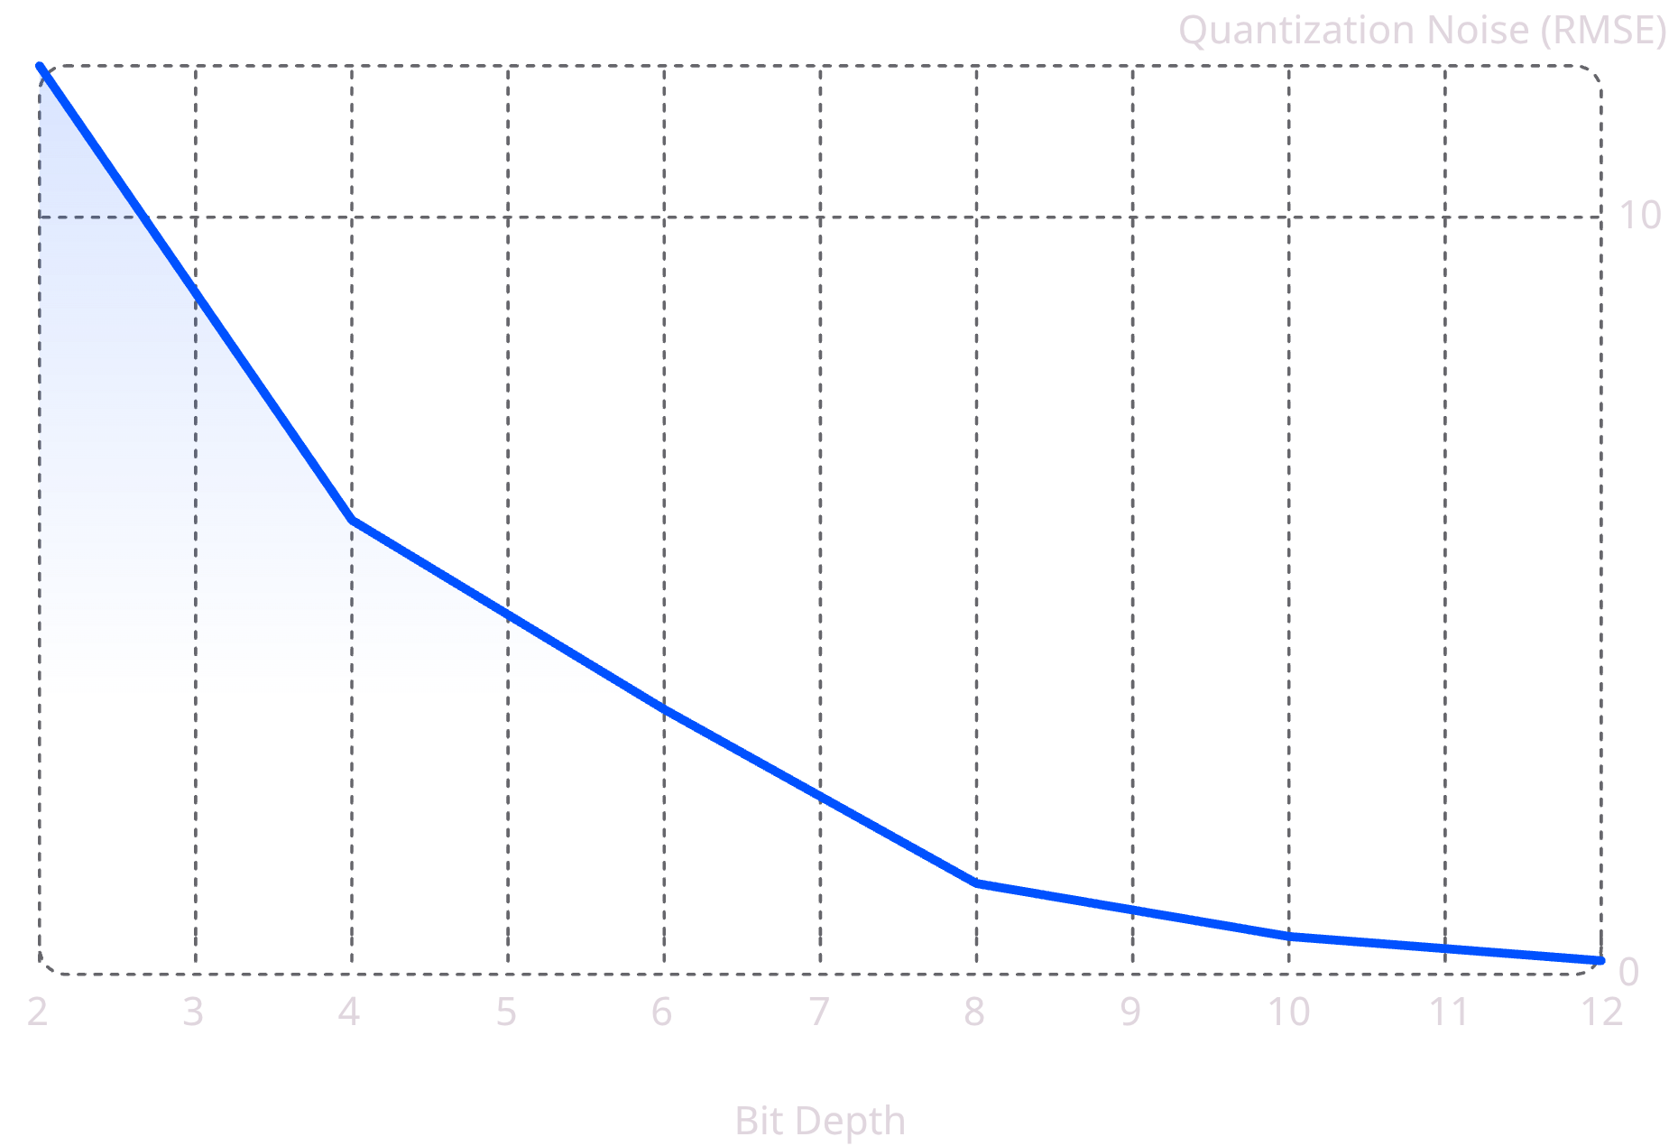
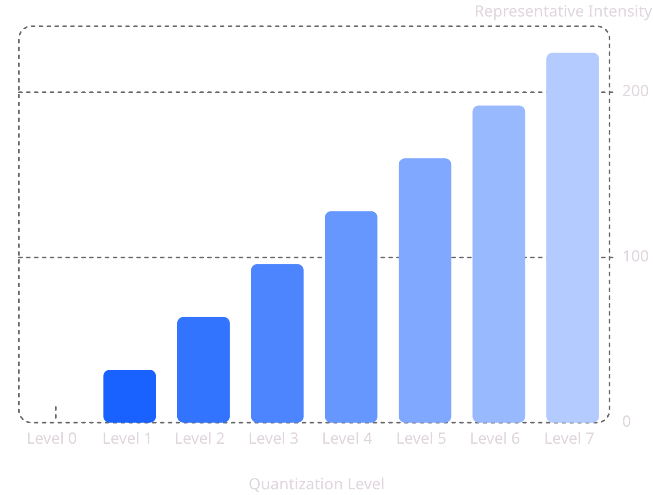
Impact and Graphical Analysis
Effects on image quality
Loss of fine details and texture
Banding / contouring in smooth gradients
Reduced contrast and dynamic nuance
Poor feature extraction → degraded recognition accuracy
Staircase/quantization-level graph: visualizes discrete steps that produce banding in gradients.
Line chart (example): measured RMSE of quantization noise vs bit depth — noise falls rapidly with increased bits.
Conclusion: Higher bit depth significantly reduces quantization noise and visible banding.

Slide 5
Applications & Noise Reduction Techniques
Relevant Applications (icons below)
Medical Imaging
Face Recognition
Diagnostic fidelity requires low-noise quantization.
Feature details must be preserved for accurate matching.
OCR
Autonomous Vehicles
Text strokes need high dynamic resolution to avoid misreads.
Sensor quantization impacts perception and safety.
Satellite Imaging
Security Surveillance
Remote sensing requires fine radiometric precision.
Low-light quantization affects identification tasks.
Noise reduction strategies
Increase bit depth and use higher-resolution ADCs
Apply dithering to decorrelate quantization error from signal
Use image enhancement and adaptive contrast techniques
Design compression-aware quantizers (rate-distortion optimized)
Post-filtering (edge-preserving denoisers, bilateral filters)

Slide 6

Conclusion & Key Takeaways
1
2
References
Quantization converts continuous intensities into discrete levels
Quantization noise is unavoidable but manageable
- Gonzalez, R. C., & Woods, R. E., Digital Image Processing (4th Ed.)
- Szeliski, R., Computer Vision: Algorithms and Applications (2nd Ed.)
Essential for digital representation but introduces error.
Design choices (bit depth, ADC, dithering) control its impact.
3
Higher bit depth → markedly better image fidelity
Reduces RMSE and visible banding; improves CV performance.

